Slide 1
10.2 MACH
Rabin Timalsina
Sameep Dhakal
Rajiv Dahal
Samrat Neupane

Slide 2
MACH
Mach is a microkernel that provides the most elementary services needed for an operating system. Its first version was built in 1986 for VAX 11/784, a cpu multiprocessor.
It is designed to be the core of a distributed UNIX-like system. It communicates via sending messages directly between different applications via ports, and handles only the most basic operating system functions on its own.
More advanced functions are handled by servers that it interfaces with.

Slide 3
GOALS OF MACH
Providing a base for building other operating systems (e.g., UNIX).
Supporting large sparse address spaces.
Allowing transparent access to network resources.
Exploiting parallelism in both the system and the applications.
Making Mach portable to a larger collection of machines.

Slide 4
THE MACH MICROKERNEL
User process
User space
System V
emulator
Software
emulator
layer
4.3 BSD
emulator
HP/UX
emulator
Other
emulator
Microkernel
Kernel space

Slide 5
THE KERNEL MANAGES FIVE PRINCIPAL ABSTRACTIONS:
Processes.
Ports.
Threads.
Memory objects.
Messages.

Slide 6
PROCESS MANAGEMENT IN MACH
Address space
process
Thread
Process
port
Bootstrap
port
Exception
port
Registered
ports
kernel

Slide 7
PROCESSES
A process can be runnable or blocked.
If a process is runnable, those threads that are also runnable can be scheduled and run.
If a process is blocked, its threads may not run, no matter what state they are in.

Slide 8
PROCESS MANAGEMENT PRIMITIVES
Create | Create a new process, inheriting certain properties
Terminate | Kill a specified process
Suspend | Increment suspend counter
Resume | Decrement suspend counter. If it is 0, unblock the process
Priority | Set the priority for current or future threads
Assign | Tell which processor new threads should run on
Info | Return information about execution time, memory usage, etc.
Threads | Return a list of the process’ threads

Slide 9
THREADS
Mach threads are managed by the kernel. Thread creation and destruction are done by the kernel.
Fork | Create a new thread running the same code as the parent thread
Exit | Terminate the calling thread
Join | Suspend the caller until a specified thread exits
Detach | Announce that the thread will never be jointed (waited for)
Yield | Give up the CPU voluntarily
Self | Return the calling thread’s identity to it

Slide 10
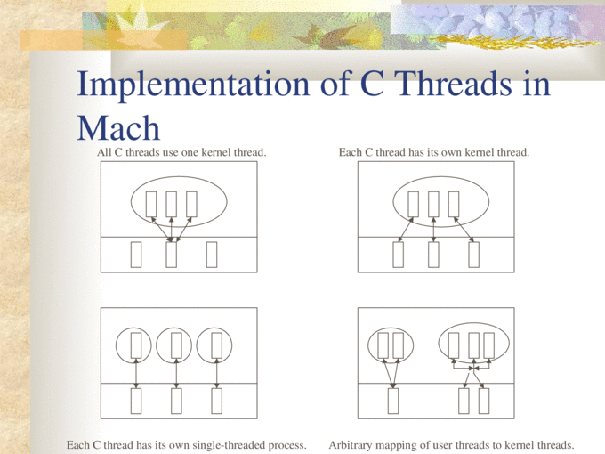

Slide 11
MEMORY MANAGEMENT IN MACH
Mach has a powerful, elaborate, and highly flexible memory management system based on paging.
The code of Mach’s memory management is split into three parts. The first part is the pmap module, which runs in the kernel and is concerned with managing the MMU.
The second part, the machine-independent kernel code, is concerned with processing page faults, managing address maps, and replacing pages.
The third part of the memory management code runs as a user process called a memory manager. It handles the logical part of the memory management system, primarily management of the backing store (disk).

Slide 12
VIRTUAL MEMORY
The conceptual model of memory that Mach user processes see is a large, linear virtual address space. The address space is supported by paging.
A key concept relating to the use of virtual address space is the memory object. A memory object can be a page or a set of pages, but it can also be a file or other, more specialized data structure.

Slide 13
AN ADDRESS SPACE WITH ALLOCATED REGIONS, MAPPED OBJECTS, AND UNUSED ADDRESSES
File xyz region
Unused
Stack region
Unused
Data region
Unused
Text region

Slide 14
SYSTEM CALLS FOR VIRTUAL ADDRESS SPACE MANIPULATION
Allocate | Make a region of virtual address space usable
Deallocate | Invalidate a region of virtual address space
Map | Map a memory object into the virtual address space
Copy | Make a copy of a region at another virtual address
Inherit | Set the inheritance attribute for a region
Read | Read data from another process’ virtual address space
Write | Write data to another process’ virtual address space

Slide 15
PORTS IN MACH
The basis of all communication in Mach is a kernel data structure called a port.
When a thread in one process wants to communicate with a thread in another process, the sending thread writes the message to the port and the receiving thread takes it out.
Each port is protected to ensure that only authorized processes can send it and receive from it.
Ports support unidirectional communication. A port that can be used to send a request from a client to a server cannot also be used to send the reply back from the server to the client. A second port is needed for the reply.

Slide 16
TYPES OF PORTS
The process port is used to communicate with the kernel.
The bootstrap port is used for initialization when a process starts up.
The exception port is used to report exceptions caused by the process. Typical exceptions are division by zero and illegal instruction executed.
The registered ports are normally used to provide a way for the process to communicate with standard system servers.

Slide 17
PRIMITIVES FOR MANAGING PORTS
Allocate | Create a port and insert its capability in the capability list
Destroy | Destroy a port and remove its capability from the list
Deallocate | Remove a capability from the capability list
Extract_right | Extract the n-th capability from another process
Insert_right | Insert a capability in another process’ capability list
Move_member | Move a capability into a capability set
Set_qlimit | Set the number of messages a port can hold

Slide 18
MESSAGE PASSING VIA A PORT
Receiving thread
Sending
thread
send
receive
port
Kernel

Slide 19
MACH MESSAGES
The Mach kernel provides message-oriented, capability-based inter-process communication.
The inter-process communication (IPC) primitives efficiently support many different styles of interaction, including remote procedure calls, object-oriented distributed programming, streaming of data, and sending very large amounts of data.
The mach_msg system call sends and receives Mach messages. Mach messages contain data, which can include port rights and addresses of large regions of memory.

Slide 20
MESSAGE STRUCTURE
Mach_msg(&hdr, options, send_size, rcv_size, rcv_port, timeout, notify_port);
The first parameter, hdr, is a pointer to the message to be sent or to the place where the incoming message is put, or both.
The second parameter, options, has a bit each for pending message and another one specifying that a message is to be received. timeout bit enables timeout. Options bits allow a SEND that cannot complete immediately to return control anyway, with a status report being sent to notify_port later.
The send_size and rcv_size parameters tell how large the outgoing message is and available bits for storing the incoming message, respectively.
Rcv_port is used for receiving messages. It is the capability name of the port or port set being listened to.

Slide 21
THE MACH MESSAGE FORMAT
Complex/Simple
Reply rights
Dest. rights
Message size
Capability index for destination port
Header
Capability index for reply port
Message kind
Not examined
by the
kernel
Function code
Descriptor 1
Message
body
Data field 1
Descriptor 2
Data field 2

Slide 22
THANK YOU!

